Slide 1

MANAGING ODOR COMPLAINTS
AT PERMITTED SITES
Case Studies: Countryside Landfill and ADS Zion Landfill
by Michael Kuhn
Solid Waste Unit Coordinator
2017 Lake County Health Department and Community Health Center
1

Slide 2

Countryside Landfill
The landfill, permitted for non-hazardous MSW, began
operating in 1976
In 1994 the county board local siting committee approved a 63 acre expansion that increased the size of the landfill to 201 acres
Prairie Crossing Subdivision was in the planning stage in 1994
An environmentally designed upscale community consisting of approximately 350 homes, condominiums, retail stores and a community farm
Subdivision was built in phases
The last phase, south end of the subdivision, was completed in 2006

Slide 3
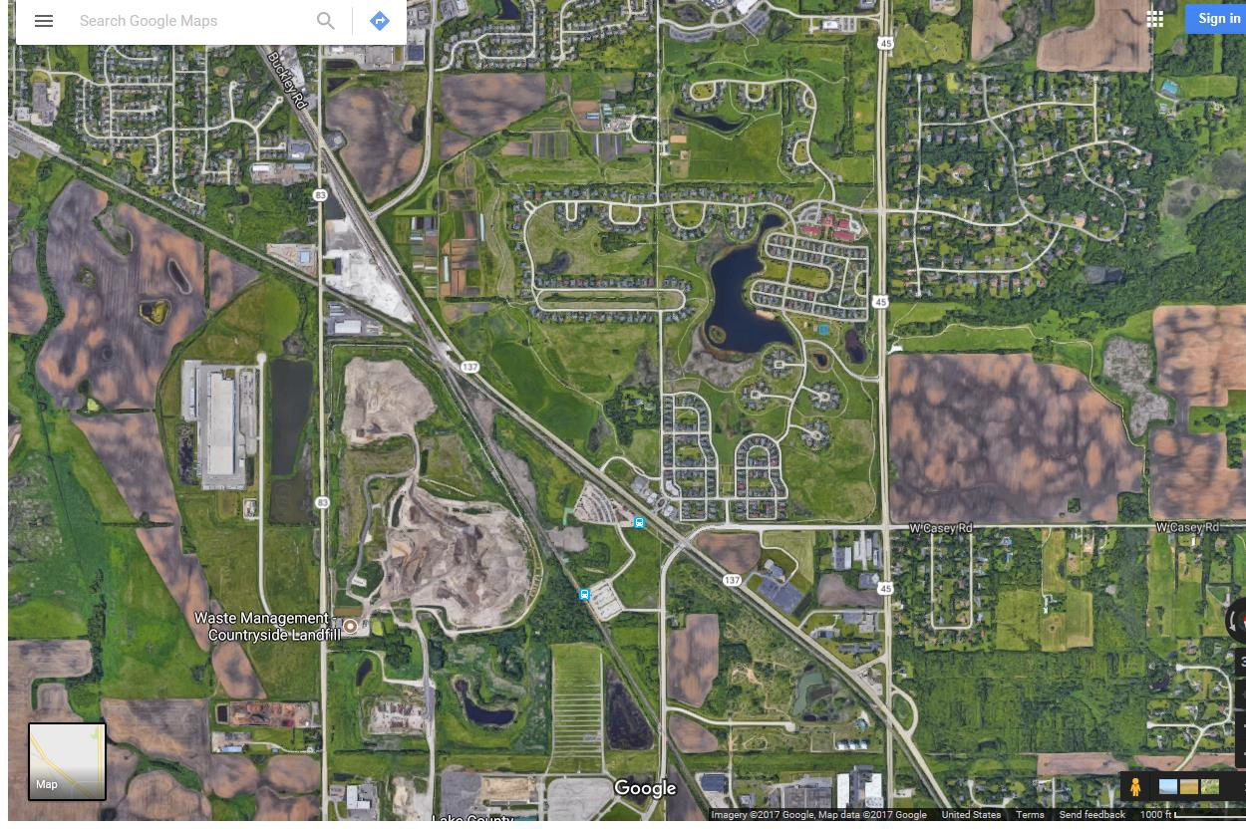
Countryside Landfill and Prairie Crossing Subdivision

Slide 4
Ground Gypsum Phenomenon
C & DD processors began grinding wallboard for volume reduction for deliveries to landfills
Microbial biodegradation of gypsum in a wet anaerobic environment produces hydrogen sulfide that some people can smell in landfill gas in concentrations as low as 1 ppb.
Countryside Landfill became aware of the ground gypsum in mid to late 2008 when off-site odors began to be reported by Prairie Crossing residents
The SWU unit started to receive complaints in July 2008 related to landfill gas and hydrogen sulfide odors

Slide 5
Old Ways and New Ways
Typically, a case would be created each time an odor complaint was reported and assigned to an inspector
An inspection would be conducted, cause investigated, steps taken or to be taken to address cause, caller notified, closed
Worked okay when complaints were reported infrequently
Dysfunctional process when multiple complaints were being
reported multiple days of the week (526 complaints in 2009)
The affected area and number of complaints kept increasing
An improved method to manage complaints was needed
Solution: rather than treating each complaint independently
each became part of a “community complaint”
Complaint would remain open until the issue was resolved

Slide 6
Community Complaint Response
A dedicated phone line was set up to report odors
Callers were asked to provide date, time, location, type of odor and intensity using a scale of 1 to 4, 4 being the strongest
The information was entered into a spreadsheet
The landfill was notified of each complaint
The caller received a phone response the same day or next business day if odors were reported after hours or on weekends
Developed partnerships with the landfill and residents

Slide 7
Landfill Partnership
LCHD, US EPA, Illinois EPA partnered with Countryside Landfill to monitor hydrogen sulfide levels and effectiveness of corrective actions
Information from the odor log in conjunction with wind direction and velocity and data from on-site hydrogen sulfide monitors was used to identify source areas
Participated on-site with the landfill manager to identify source areas
Collaborated with landfill manager on locations to install horizontal gas collection systems to supplement vertical gas collection wells that had a limited cone of influence due to moisture and density of the waste mass

Slide 8
Checked wood waste stockpiles during landfill inspections for signs of ground gypsum to verify C&DD processors had stopped mixing it with wastes for delivery as landfill management had warned it would not be accepted
Post USEPA project, SWALCO and the County of Lake (local siting jurisdiction) entered into an agreement requiring on- site hydrogen sulfide instruments to monitor hydrogen sulfide 24/7 and established H2S emission standards
10

Slide 9
COMMUNITY PARTNERSHIP
Provided an outlet where residents could report odors and vent their frustrations
Kept residents abreast of corrective actions and timeframes
Fact sheets were sent to all PC residents outlining and updating the LCHD, US EPA, Illinois EPA, Countryside Landfill project to eliminate the odors
Tracked effectiveness of corrective actions utilizing odor reporting data and spreadsheets
Continued responding to residents complaints with follow up phone calls and in-person visits after hours and on weekends when residents were home
Purchased a portable H2S instrument to take readings in the
community

Slide 10
Conducted odor assessments in the community as part of weekly landfill inspections
Kept the area’s county board representative updated on corrective actions and timelines so the representative could provide current and factual information if constituents called

Slide 11
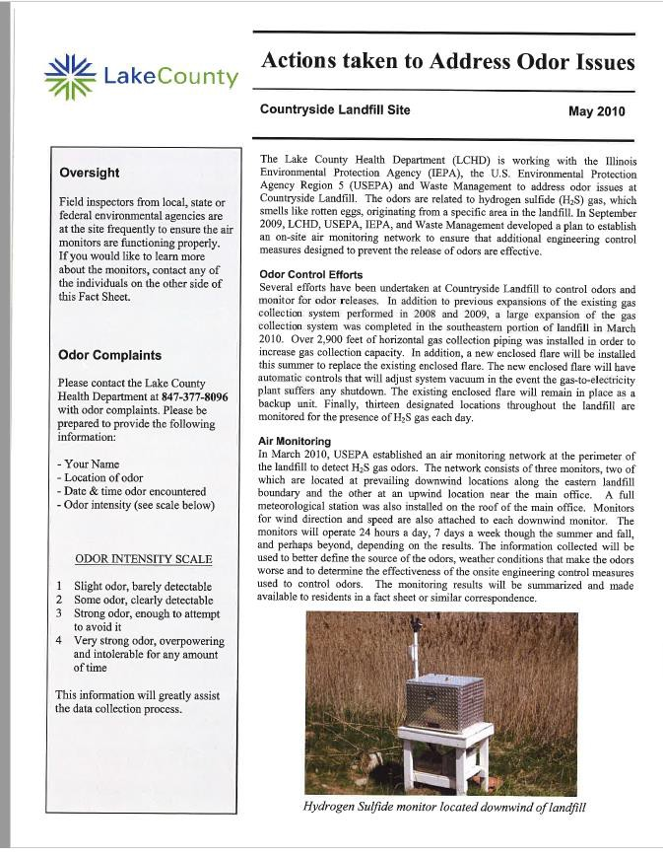
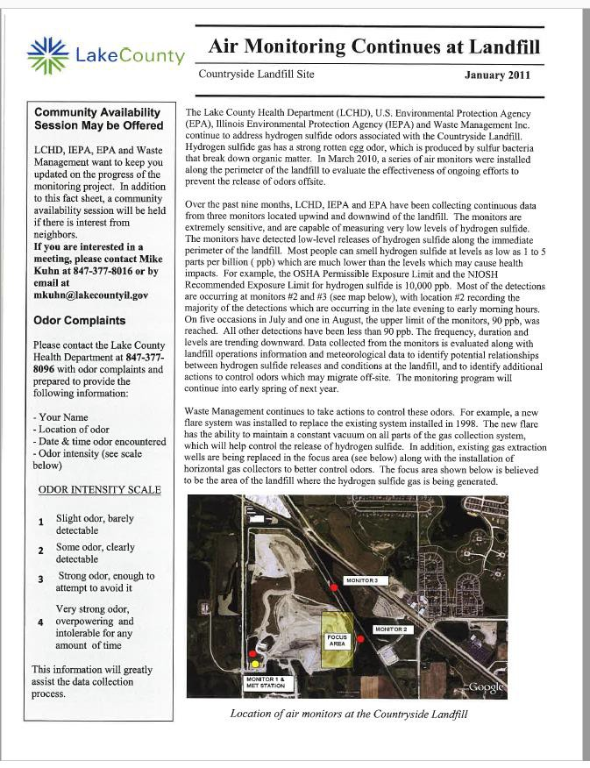
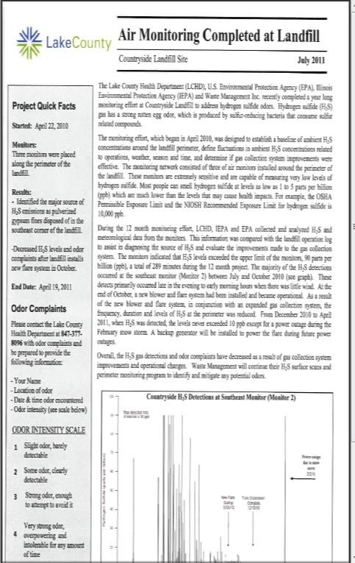
FACT SHEETS SENT TO RESIDENTS

Slide 12
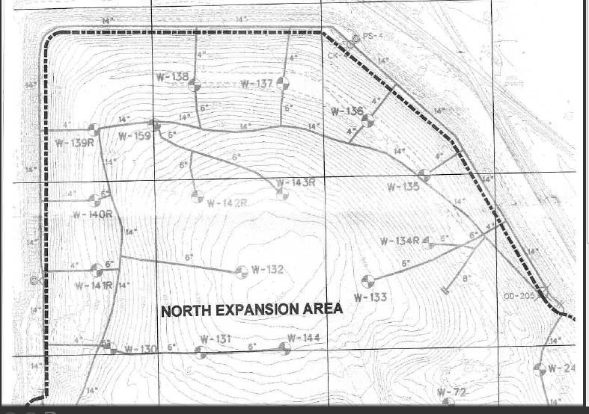
North Expansion Area

Slide 13
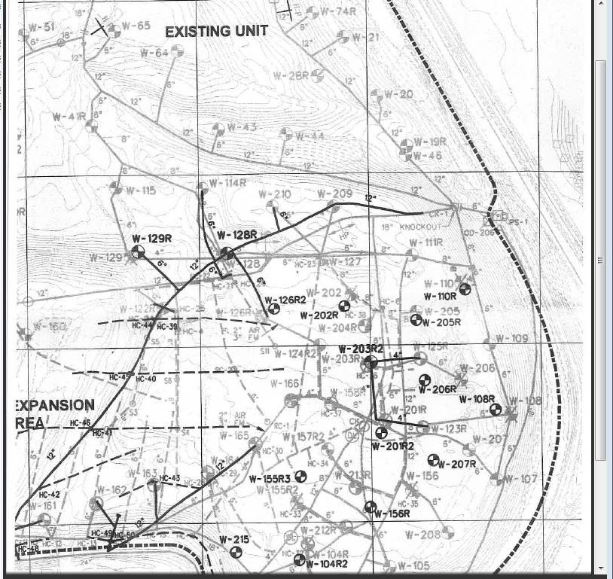
Cell 5

Slide 14
Complaints Received Per Year
Odor complaints in 2009: 526
Odor complaints in 2010: 280
Odor complaints in 2011: 190
Odor complaints in 2012: | 94
Odor complaints in 2013: | 56
Odor complaints in 2014: | 124
Odor complaints in 2015: | 53
Odor complaints in 2016: | 53
Odor complaints in 2017: | 31

Slide 15
ADS ZION LANDFILL
The landfill began operating in 1980
Obtained local siting approval to expand in 1995 and 2010
The 2010 approved a vertical and vertical/horizonal
expansion of 26.5 acres
Expansion allowed the landfill to move closer to residential communities
Reduced buffer for odor and noise dissipation
Additional land was purchased in 2016 for potential expansion to the north, also near a residential subdivision
Off-site garbage odor complaints increased after waste
disposal commenced in the expansion cell in April 2016

Slide 16
Noise complaints are also increasing
Lawsuit against the landfill has been filed by residents
Reportedly, trial date set for June 2018

Slide 17
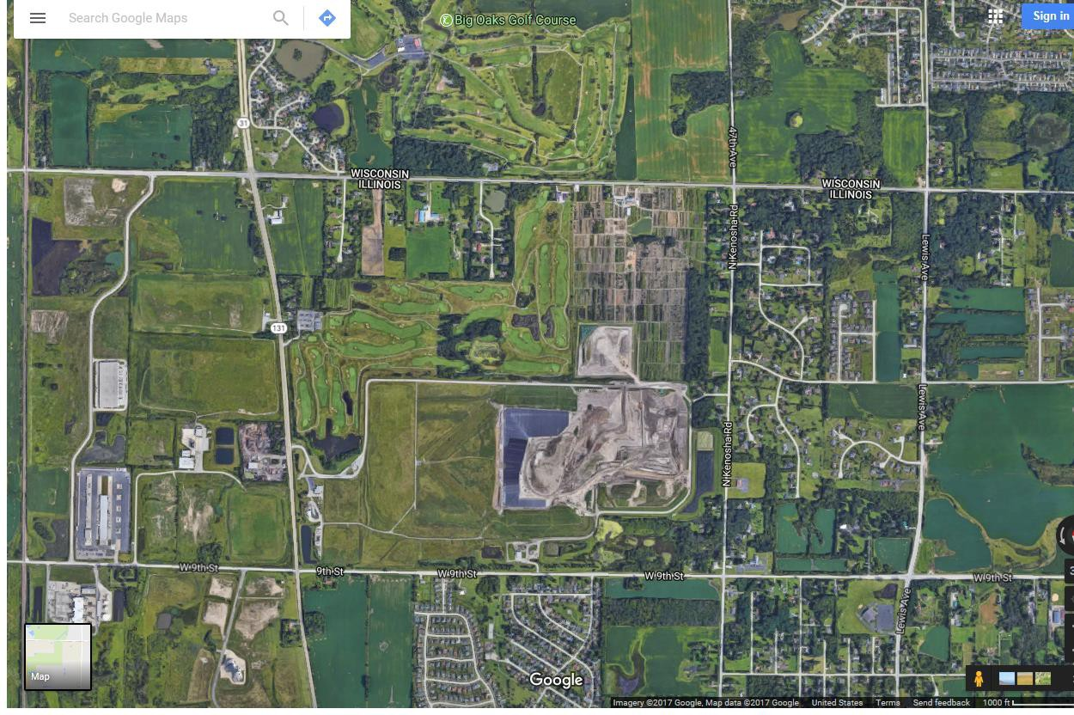

Slide 18
Community Complaint Approach
Utilize the dedicated phone line for reporting odors
Record the information on the spreadsheet
Respond to complainants the day received or by the end of the next business day for complaints received during evenings or weekends
Document whether or not response was satisfactory
Notify the landfill of the odor complaints
Pursue partnerships with the landfill and community
20

Slide 19
Landfill Partnership
Maintain good lines of communication so information is shared freely especially related to suspected causes for odors beyond waste deliveries
Keep abreast of the landfill’s efforts to control odors
Explore additional odor control ideas with landfill management to reduce the frequency and impact
Research ideas independently and offer suggestions to
landfill management
Landfill implementation of suggestions i.e. odor neutralizer system expansion along north property boundary, use of high calcium lime for odor control, portable ONS that can be positioned where appropriate for supplemental control

Slide 20
Community Partnership
Remain calm and empathetic with frustrated resident
Inform residents of efforts being made by the landfill to control garbage odors, i.e., optimizing the odor neutralizing system (ONS), trying different ONS products for effectiveness, maintain a small active face, orient active face according to wind direction when possible, spreading high calcium lime, using the portable ONS when/where it’s applicable, monitoring off-site odor levels
Inform residents of efforts to divert food scraps which will reduce the amount of putrescible wastes going into the landfill and reduce off-site odors, potential exists for new odor control technologies and products
Don’t raise false expectations

Slide 21
REALITY CHECK
At Countryside Landfill there was a definite end point, the only question was how long would it take to get there
At the ADS Landfill, controlling garbage odors is on-going
endeavor with no definite end point in sight
Residents will likely tire of the “community complaint” approach if they don’t see or perceive the situation is improving
Finding ways to control/prevent off-site garbage odors must remain a top priority

Slide 22
Odor Complaints Reported by Phone
• 2010: | 52
• 2011: | 50
• 2012: | 42
• 2013: | 28
• 2014: | 19
• 2015: | 70
• 2016: | 95
• 2017: | 179 as of September 27

Slide 23

Questions
This Photo by Unknown Author is licensed under CC BY

Slide 24



3010 Grand Avenue, Waukegan, Illinois 60085
Phone: (847) 377-8000
http://health.lakecountyil.gov
2017 Lake County Health Department and Community Health Center

