Slide 1
How Illinois Counties Can Opt-In To The New Consumer Electronics Recycling Act
Welcome to the Webinar – The Webinar will begin shortly.
Your computer or phone will be in listen only mode for the entire program.
Please feel free to send questions during the program.
We will do our best to answer questions at the end of the program and will publish a list of questions and answers from the program on the www.ilcswma.org web site.
A link to a recording of this program will be sent to you following its conclusion and will also be available on the ILCSWMA web site.

Slide 2
How Illinois Counties Can Opt-In To The New Consumer Electronics Recycling Act
Pete Adrian, ILCSWMA Board Member
Walter Willis, Executive Director Solid Waste Agency of Lake County (SWALCO)

Slide 3
Todays Agenda
Introduction to the Illinois Counties Solid Waste Management Association (ILCSWMA)
Overview of the Consumer Electronics Recycling Act (CERA)
Key implementation dates under the new law
Collection Options – Notice of Participation template
Opting Into CERA – Filing your Notice of Participation
ILCSWMA continued assistance to counties

Slide 4
Before We Begin
ILCSWMA is facilitating communications regarding CERA, including this webinar, as there are many counties in Illinois which are unserved or underserved by electronics recycling programs.
ILCSWMA hopes this outreach will result in a significant increase in the number of Illinois citizens who have access to electronics recycling services.
Please keep in mind that ILCSWMA did not write the CERA legislation; we are merely working to educate county officials state wide about this law and its potential impacts.
We know that there are many questions about the implementation of CERA. ILCSWMA does not likely possess all the answers to these questions at this time. This Association is, however, collecting questions on behalf of county governments and will do our best to vet them through CTA (the electronics' trade association) and the Illinois EPA for the best possible answers.

Slide 5
What is ILCSWMA?
The Illinois Counties Solid Waste Management Association is professional association of local level solid waste professionals throughout the state of Illinois.
ILCSWMA represents areas of solid waste, including waste collection, process & disposing, recycling & waste prevention, regulation & enforcement, information & education.
ILCSWMA provides our members with legislative updates, regional meetings, bi-monthly newsletters and an annual conference.
To access a recording of this presentation and more information please visit our website www.ilcswma.org

Slide 6
Are you a ILCSWMA member? Now is the best time to join!
For 2018, in honor of the Association’s 25th Anniversary, we are offering a new member rate of $25. If your organization (full or affiliate) has not been a member for at least the past two years, you are eligible to join for this reduced rate.
Full Membership is regularly $100 Annually
(County, municipal, or township units of government and regional planning commissions)
Affiliate Membership is regularly $75 Annually
(State agencies and organizations, consulting firms, colleges & universities, Keep Illinois Beautiful affiliates, service providers, community groups)
Membership is valid from January 1 to December 31 each year.
Membership belongs to organizations, not individuals. All employees of member organizations are eligible for discounted conference rates and more.
You won't find a better value out there than ILCSWMA membership!
To join, please visit our website at www.ilcswma.org

Slide 7
Overview of CERA
With enactment of PA 99-0013 (HB 1455) in 2015, stakeholders recognized need for long term fix
In 2016 & 2017 two separate bill drafts were prepared by IL PSC and IMA
Negotiations culminate in two bills being passed in 2017 and signed into law
SB 1417 (PA 100-0433)
HB 1955 (PA 100-0362), trailer bill
A copy of PA 100-433 is provided as an attachment to the right
A copy of PA 100-433 will also be available on the ILCSWMA web site
Also attached is a sample resolution that Counties can consider passing to formally authorize an opt in to the program. The law does not require this but we assume most staff will be looking for county board approval in some manner, and a resolution is the likely vehicle.

Slide 8
Overview of CERA
Consumers Technology Association requesting additional amendments to law:
Need for antitrust protection for the clearinghouse
Allocation of costs among the manufacturers put directly into law, avoid rulemaking
SWALCO has asked for inclusion of drop-off recycling option in Section 1-10(d), in addition to curbside programs offered by haulers being included in the State program

Slide 9
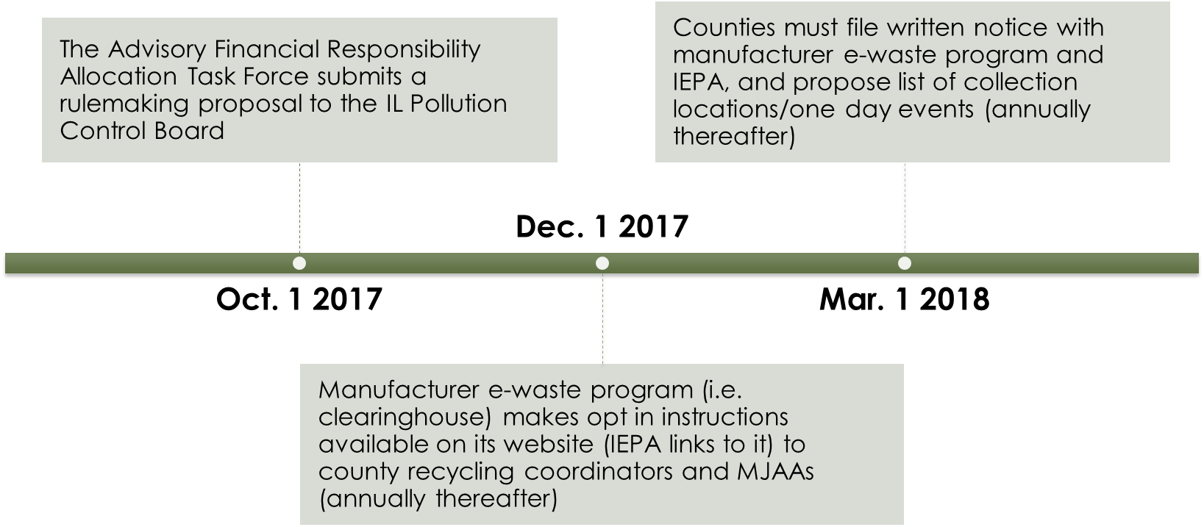
Overview of CERA – Key Dates

Slide 10
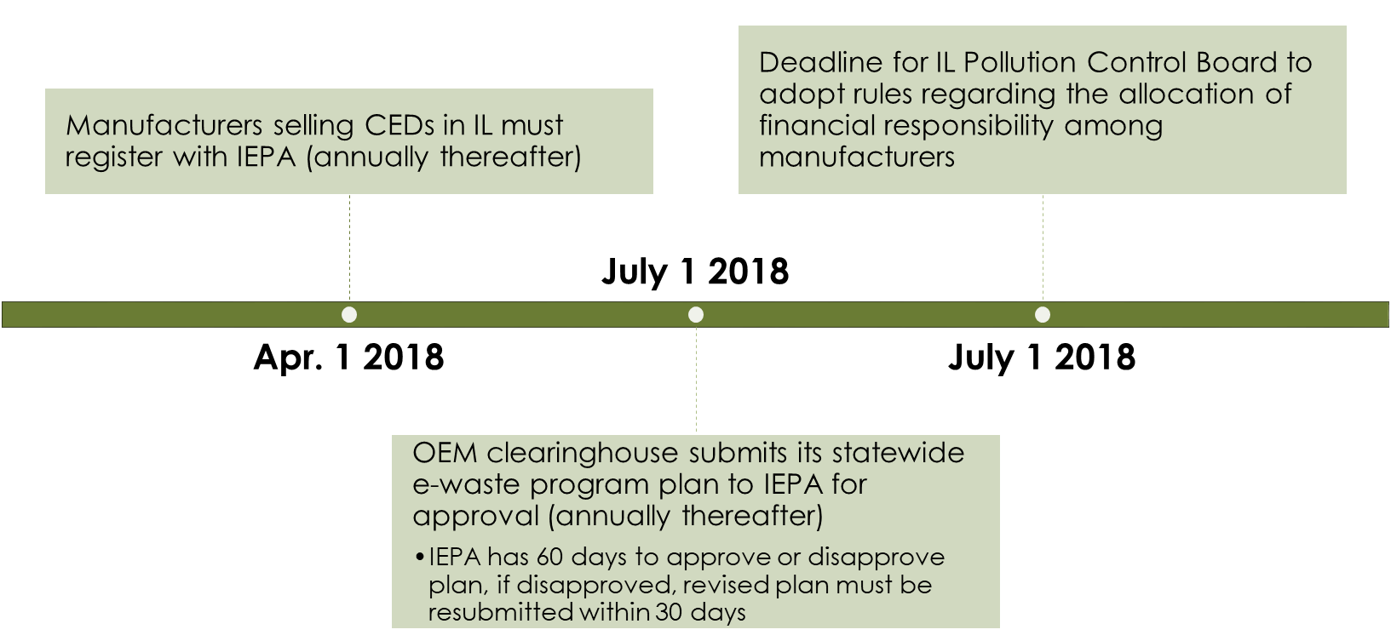
Overview of CERA – Key Dates

Slide 11
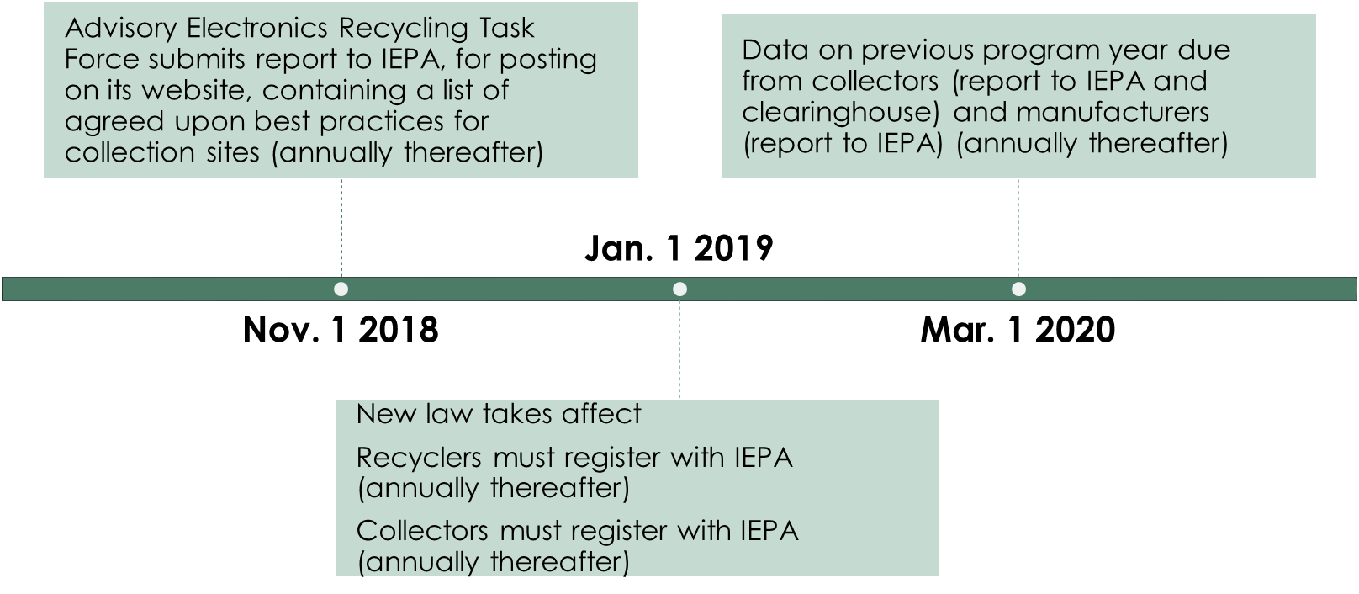
Overview of CERA – Key Dates

Slide 12
Role and Responsibilities - Manufacturers
Register annually with IEPA and either join the clearinghouse or run unilateral statewide program
Administer clearinghouse
Develop statewide plan based on counties opting in, and implement convenience standard
Assume financial responsibility for implementing e-waste program, including costs for packaging materials, bulk transportation and recycling
Audit collection sites
Submit annual report on program year collection data

Slide 13
Role and Responsibilities – Illinois EPA
Overall enforcement of the law’s provisions
Administer registration of manufacturers, recyclers and collectors
Annually review and approve/disapprove e-waste program plan submitted by manufacturers
Post instructions on how to opt into program on website, instructions developed by manufacturers
Collect, collate and track annual program data
Assist with calculations on cost allocation for clearinghouse

Slide 14
Role and Responsibilities - Recyclers
Provide the key function of recycling the recovered CEDs, will likely continue to have direct contracts with manufacturers that cover costs of transportation and recycling
Register annually with IEPA and certify compliance with 13 provisions in the law (labor law compliance, heath and safety training, insurance, use of proper equipment, etc.)
Provide key collection data used by manufacturers and collectors to comply with annual reporting requirements
Assume key role with collectors to improve best practices at collection sites

Slide 15
Role and Responsibilities - Collectors
Work with county recycling coordinators to provide sites or one day events (can include local government, NGOs, private sector such as haulers or scrap yards, Goodwill, retailers, etc.)
Register annually with IEPA
Provide the sorting and loading of CEDs per the state law or face pro rata transportation charge from recycler
May charge for monitors and TVs to cover cost of sorting and loading the CEDs
Submit annual report on program year data

Slide 16
Collection Options for Counties to Consider
County/local gov’t site, with county/local gov’t staff sorting and loading trailers
County/local gov’t site, with private vendor contracted to sort and load electronics
Private site (e.g., hauler, scrap yard), with private vendor contracted to sort and load electronics
Curbside collection or hauler provided drop off as part of hauling contract
Name retail location(s) as collection sites (retailer must approve)

Slide 17
Opting Into CERA - Considerations
Do you want to be an active partner with the manufactures?
It’s an annual decision - if not this year then maybe next
Can you team with other entities in your county?
Do you want a permeant collection site or one-day collection events?
Is this an important service to provide for your residents or can they find other recycling options in your county?

Slide 18
Opting into CERA - Written Notice
Must be a written notice of election submitted by March 1, 2018 with the following information:
Government Agency (County/Regional)
Name, email address and phone number of County contact
Proposed collection locations likely to be available
Describe staffing of collection sites (Requirement of county to define)
List preferred collection method or collector
May include list of preferred registered recyclers
If collections occurred in County in 2017 how much was collected and noting any changes that may impact this amount collected.
Provide assurance that collector(s) will meet standard established in Section 1-45(e) of the Act.
Notification to Illinois EPA and CTA

Slide 19
Opting into CERA - Written Notice

Slide 20
Opting into CERA - Written Notice
Please refer to the CERA Notice of Participation template with sample responses that has been provided as an attachment to the right.
The CERA Notice of Participation template and sample responses as well as all of todays attachments will also available on the ILCSWMA web site.
Unless otherwise directed from the CERA page of the Illinois EPA web site – Written Notice should be submitted to:
Mr. James Jennings - James.M.Jennings@illinois.gov
Manager, Waste Reduction and Compliance Section
Bureau of Land
Illinois Environmental Protection Agency
1021 North Grand Ave. East
Springfield, Illinois 62794
(217) 524-1852
Mr. Walter Acorn - walcorn@cta.tech
Vice President of Environmental Affairs and Industry Sustainability
Consumer Technology Association
1919 S. Eads Street
Arlington, VA 22202
(703) 907-7765

Slide 21
Opting into CERA Step 1: Program Collection Site Information
Explanation of number of collection sites and /or one-day collection events:
Explain how many collection sites and/or one-day collection events you plan to have in your jurisdiction, and if you have exact locations, provide them.
If you do not have exact locations and dates, provide the level of detail you are able to at that time. Ideally, you will have collection sites identified but providing details on the one-day events will likely be more difficult.

Slide 22
Opting into CERA – Step 1 Cont.
Description of collection site and/or one-day collection event operations:
Describe who will be overseeing the collection site and/or one-day collection events, and what arrangements, if any, have been made to secure the needed assistance to operate the collection site(s) or one-day event (include any contracts or intergovernmental agreements).

Slide 23
Opting into CERA – Step 1 Cont.
Explanation of education:
Provide examples of and/or an explanation of how you plan to educate residents about the site and what materials are and are not accepted, including the limit on 7 CEDs per visit.
The manufacturers want to be sure these sites take in eligible program weight and your education effort should address this concern.

Slide 24
Opting into CERA – Step 1 Cont.
Preferred Recycler(s):
Provide a list of the preferred recyclers you would like to work with for your program, be ready to list them in order of priority.

Slide 25
Opting into CERA – Step 1 Cont.
Explanation of any deviations from convenience standard guidelines:
Explain any deviations you may have from the convenience standard guidelines as far as increasing the number of sites pursuant to Section 1-15(a) of the Act.
Provide an explanation on why your program needs more sites than the minimum provided for in the Act.

Slide 26
Opting into CERA – Step 1 Cont.
Status of any written agreement with Manufacture’s:
Include any agreement you may have entered with the manufacturers pursuant to Section 1-15(b)(1) or (2) of the Act.
This pertains to decreasing the number of collection sites you are eligible for or trading in your collection site for up to 4, one-day collection events.

Slide 27
Opting into CERA – Step 1 Cont.
Proof of agreement with retailer acting as collection site:
If you plan to name a retailer as one of your collection sites you must have an agreement with that retailer for it to be recognized by the manufacturers.

Slide 28
Opting into CERA Step 2: Previous Year Program Data
Provide data on previous year collections:
Provide data on the electronics collected in your program in 2017.
The manufacturers are especially interested in existing collection sites that will also be active in 2019, and this data will give them a good estimate of what they can expect from that site in 2019.
Provide any data you have for one-day events as well.

Slide 29
Opting into CERA – Step 2 Cont.
Explain any changes to collection sites that might affect the amount that will be collected for the program year:
For existing collection sites that you plan to have active in 2019, note any changes at the collection site or under your program that might affect the amount collected in 2019.
For example, many collection sites are seeing a slow decline in weight collected as the CRTs finally start to flush out, any trend data you have should be shared.

Slide 30
Opting into CERA Step 3: Assurance Collection Standards (Section 1-45(e)) Will be Met
Will you be accepting electronics that are not CED’s?
If you answer no to the question, you do not need to explain any further.
If you answer yes to the question, explain how the cost to recycle these items will be covered:
If you decide to accept electronics that are not listed as a CED, you should provide a copy of the contract or agreement you have with the recycler to manage the recycling cost for that material outside of the program (Section 1-45(e)(5)).
The material can still ride along on the same truck, but the recycling costs must be kept separate from the CEDs the manufacturers are paying to have recycled.

Slide 31
Opting into CERA - Step 3 Cont.
Explain site collection, sorting and loading methods as they pertain to Section 1-45(e) of the Act:
Provide information on your current program and how effective you have been at sorting and loading per your recycler’s requirements.
Provide truck weights to demonstrate you are close to or are meeting the 18,000-pound goal in the Act.
Provide examples of the education you use at the site, your website, newsletters, etc. that limit the program to residential CEDs and mention the 7 CED limit (it is 10 currently, but decreases to 7 in 2019).

Slide 32
Opting into CERA - Step 3 Cont.
Explain the record keeping and tracking practice to be utilized:
Describe the current bill of lading/manifest program you have in place with your recycler that ensures that only trailers coming from your sites will be counted as program weight.
The manufacturers are still concerned about ghost weight or unauthorized electronics getting into the program, therefore they want government involvement in the sites, so we can play the role of regulator.
We must provide them with assurances that the programs will be run in accordance with the law and every effort will be made to ensure that non-eligible electronics will not be accepted.

Slide 33
What’s Next
ILCSWMA will host regional meetings in February 2018 to assist counties with opt-in process to the electronics program.
Southern Region – Thursday, February 8, 2018
Northern Region – Wednesday, February 13, 2018
Central Region – Friday, February 23, 2018
ILCSWMA will continue to provide counties with examples of permanent sites and one day collection event best practices.
ILCSWMA will continue to update members with any new information moving forward with the Consumer Electronics Recycling Act.

Slide 34
Questions and Answers: Contact your ILCSWMA Region Representative
Southern Rep: Kim Petzing - kspetzing@co.madison.il.us
(Counties covered: Alexander, Bond, Calhoun, Clay, Clinton, Crawford, Edwards, Effingham, Fayette, Franklin, Gallatin, Greene, Hamilton, Hardin, Jackson, Jasper, Jefferson, Jersey, Johnson, Lawrence, Macoupin, Madison, Marion, Massac, Monroe, Montgomery, Perry, Pope, Pulaski, Randolph, Richland, Saline, St. Clair, Union, Wabash, Washington, Wayne, White and Williamson)
Central Rep: Chad Braatz - chad.braatz@cityofmonmouth.com
(Counties covered: Adams, Brown, Cass, Champaign, Christian, Clark, Coles, Cumberland, DeWitt, Douglas, Edgar, Ford, Fulton, Hancock, Henderson, Henry, Iroquois, Knox, Livingston, Logan, Macon, Mason, McDonough, McLean, Menard, Mercer, Morgan, Moultrie, Peoria, Piatt, Pike, Rock Island, Sangamon, Schuyler, Scott, Shelby, Tazewell, Vermilion, Warren and Woodford)
Northern Rep: Pete Adrian – padrian@swalco.org
(Counties covered: Bureau, Boone, Carroll, Cook, DeKalb, DuPage, Grundy, JoDaviess, Kankakee, Kane, Kendall, Lake, LaSalle, Lee, Marshall, McHenry, Ogle, Putnam, Stark, Stephenson, Whiteside, Will, and Winnebago)
Walter Willis – wwillis@swalco.org
Or, send your questions to info@ilcswma.org

Slide 35
Questions and Answers: Continued
Please fill out the brief survey that will pop up after we sign off today.
Dialogue on this topic will continue at our reginal meetings in February, so please join us.
In the meantime pleas free to send questions to ILCSWMA via our regional representatives or at info@ilcswma.org
We will do our best to answer your questions and publish them on the ilcswma.org web site as quickly as possible.
A link to a recording of this program will be sent to you following its conclusion and will also be available on the ILCSWMA web site.
If your not an ILCSWMA member yet, please consider joining at our $25 for 25 years special anniversary rate.
Thank your for joining us today.

